Slide 1

Blockchain course HOW TO DESTROY BITCOIN: GAME THEORY AND ATTACKS
Dr. Norbert Oláh
Notes:
Hi everyone and welcome to Blockchain Fundamentals Decal Lecture 5.
Brief introduction of self.
This lecture is discussing attacks in the Bitcoin network from game theory perspective. We’ll be taking all of our previous knowledge that we’ve learnt about Bitcoin in this decal and analyze them using a little bit of game theory math.
This lecture marks our last lecture of talking about bitcoin in general and after this we will transition into higher level concepts like scaling etc.
One thing to note is that although we will be talking about bitcoin, most of the attacks that I mention are generally true for all proof-of-work blockchains that you will find out there, so keep that in mind.

Slide 2
Table of Contents
POOL STRATEGIES
FORKING & DOUBLE SPENDING
CENSORSHIP
SELFISH MINING
DEFENSES DISCUSSION

Slide 3
POOL STRATEGIES
Notes:
Right now lets talk about mining pools and mining pool strategies.
Miners = in this context we need to think of them as rational individuals who are interested in and driven by gaining a profit.
Mining pools are covered in the previous lecture, mention that this kind of ties into what we were talking about before
Why is it dangerous for people to be incentivized to join mining pools? We’ll see in the first section of the lecture

Slide 4

POOL REWARD SCHEMES
PAY-PER-SHARE
Pool pays out at every share submitted. By default will be proportional to work done by individuals
More beneficial for miners
Individual miners have no risk from reward variance
Pool takes on the risk completely
Problem: No incentive for individuals to actually submit valid blocks
Individuals are paid regardless
Notes:
Earlier we talked about payout schemes such as pay per share where as long as you are trying different hashes and using your compute power to contribute, then you will get paid. Share = near a valid block.
However, in pay per share there is no incentive for a miner to submit valid blocks to the pool, instead they can do useless work and still receive a share of the profits because of how the payout scheme is structured.
This scheme is more beneficial for the miners
Why can’t pools check that there’s beneficial work for pay-per-share?
share = something awarded to miner when they present a valid partial proof of work.

Slide 5
POOL REWARD SCHEMES
PROPORTIONAL
Pool pays out when blocks are found, proportional to the work individuals have submitted for this block
More beneficial for the pool
Individual miners still bear some risk in variance proportional to size of the pool
Not a problem if pool is sufficiently large
Lower risk for pool operators - only pay out when reward is found
Individuals thus incentivized to submit valid blocks
Notes:
Pays out when a block is found. Proportional to the work individuals have submitted for this block. This is more beneficial for the pool, and individual miners still bear some risk in variance proportional to size of pool. Lower risk for operators - only pay out when reward is found.
Clear difference between these two payout schemes -- Begs the question
*Next slide*

Slide 6
POOL REWARD SCHEMES
INCENTIVE MISALIGNMENT
Is it possible that mining pools are vulnerable to some incentive misalignment? Can miners take advantage of the differences in these two types of payout schemes?
Notes:
Read slide

Slide 7
POOL REWARD SCHEMES
INCENTIVE MISALIGNMENT
Is it possible that mining pools are vulnerable to some incentive misalignment? Can miners take advantage of the differences in these two types of payout schemes?
YES!

Slide 8
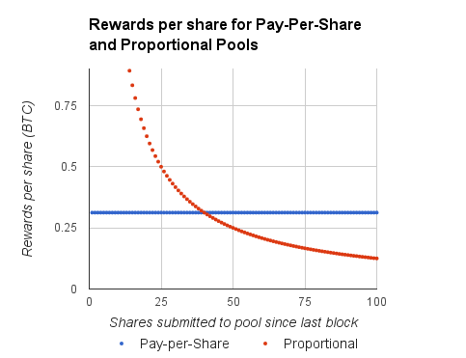
POOL REWARDS
POOL HOPPING
Proportional pool rewards per share high when just starting on a new block, but inversely proportional to number of shares submitted
Pay-per-share pool rewards per share constant no matter how many shares submitted
How does a miner maximize their profit?
Parameters:
Pool has 10% of network hashrate
4 shares expected per valid block
Notes:
These graphs show the rewards per share vs the shares submitted to the pools since the last block and how it differs for proportional mining pools and pay per share mining pools.
So now given this, I want to reiterate the statement we made earlier about how miners should always be treated as rational actors who are looking to maximize their profit. how does a miner maximize their profit?

Slide 9
POOL REWARDS
POOL HOPPING
Proportional pool rewards per share high when just starting on a new block, but inversely proportional to number of shares submitted
Pay-per-share pool rewards per share constant no matter how many shares submitted
How does a miner maximize their profit?
Parameters:
Pool has 10% of network hashrate
4 shares expected per valid block
Notes:
Explain this graph

Slide 10
POOL REWARDS
POOL HOPPING
Proportional pool rewards per share high when just starting on a new block, but inversely proportional to number of shares submitted
Pay-per-share pool rewards per share constant no matter how many shares submitted
How does a miner maximize their profit?
Parameters:
Pool has 10% of network hashrate
4 shares expected per valid block
Notes:
Explain this graph

Slide 11
POOL REWARDS
POOL HOPPING
Pool hopping: switching between pools to increase total rewards
Proportional pool pays larger amount per share if a block is found quickly
Example profit maximizing strategy:
Mine at proportional pool shortly after a block was found (while rewards are high)
Switch to pay-per-share pool when once proportional pool is less profitable
Parameters:
Pool has 10% of network hashrate
4 shares expected per valid block
Notes:
Explain optimal strategy as being the one where each graph is greater than the other

Slide 12
POOL REWARDS
POOL HOPPING
Therefore, proportional pools are not feasible in practice
Honest miners who stay loyal to one pool are cheated out of their money
Designing a mining pool reward scheme with aligned incentives that is not vulnerable to pool hopping remains an open problem
Parameters:
Pool has 10% of network hashrate
4 shares expected per valid block
Notes:
So we can thus create an optimal strategy where we stay with a proportional pool and hope that we find a block, and switch to a pay-per-share pool as soon as it dips below the other graph. However this results in honest and loyal miners being cheated out of returns by rational profit seeking miners, which is why proportional mining pools generally are not feasible in practice.
Designing a mining pool reward scheme with aligned incentives that is not vulnerable to pool hopping remains an open problem
Proportional mining pool incentivizes Valid work -- doesnt incentivize miner loyalty
Pay per share incentivizes miner loyalty, doesnt incentivize valid work

Slide 13
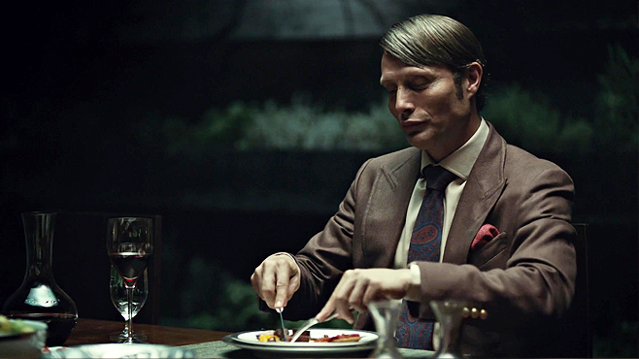
POOL CANNIBALIZATION
NOM NOM NOM NOM
Cannibalizing Pools - Distribute some small % of mining power equally among all other pools, withhold valid blocks.
Rewards will still be received
Undetectable unless statistically significant
Image source: http://cdn3-www.craveonline.com/assets/uploads/2014/08/Hannibal-Cookbook.jpg
Notes:
therefore, more pay per share models exist out in the world. And this results in a problem called pool cannibalization. Pool cannibalization is basically where you are in a lot of mining pools and you distribute some small percentage of mining power equally among a lot of other pools and withhold valid blocks, and this way you are getting a fixed amount of profit while contributing nothing and therefore eating away at their overall effectiveness.
Basic Heuristic: If you have 10% of network hashrate, then you want to additionally cannibalize up to 10% of the hashrate of other pools
Potential solutions:
-Closed pools
-Increase reward for a block significantly compared to a share, defeats the purpose of mining pools

Slide 14
POOL CANNIBALIZATION
EXAMPLE
Givens:
We have 30 H/s. Total network is 100 H/s.
Assume 1 BTC block reward. All of the following numbers are expected value.
30% HR (hashrate)
= 30% MR (Mining Reward)
= 0.3 BTC
Let’s say we buy more mining equipment, worth 1 H/s
Standard mining strategy:
Add 1% HR => 31/101 = 30.69% HR
Reward: 0.3069 * 1 BTC = 0.3069 BTC
Revenue gain = 0.0069 BTC for 1% hashrate added
New Hashrate | 31/101 ≈ 30.69%
Mining Reward | 0.3069 BTC
Revenue Gain | 0.0069 BTC
Notes:
Go through example

Slide 15
POOL CANNIBALIZATION
EXAMPLE
Pool cannibalizing strategy:
Distribute 1 H/s among all other pools
DON’T SUBMIT VALID BLOCKS
Other pool hashrate breakdown:
70/71 honest, 1/71 dishonest
70% effective hashrate = 0.7 BTC
You own 1/71 of other pools
Expected value of mining: (1/71) * 0.7 BTC = 0.0098 BTC
New Hashrate | 31/101 ≈ 30.69%
Mining Reward | 0.3098 BTC
Revenue Gain | 0.0098 BTC
Notes:
Go through example

Slide 16
POOL CANNIBALIZATION
EXAMPLE
More profitable to cannibalize pools than mine honestly
Givens:
We have 30 H/s. Total network is 100 H/s.
Assume 1 BTC block reward. All of the following numbers are expected value.
30% HR (hashrate)
= 30% MR (Mining Reward)
= 0.3 BTC
Let’s say we buy more mining equipment, worth 1 H/s
Honest
Mining Reward | 0.3069 BTC
Revenue Gain | 0.0069 BTC
Cheat
Mining Reward | 0.3098 BTC
Revenue Gain | 0.0098 BTC
Notes:
Go through example

Slide 17
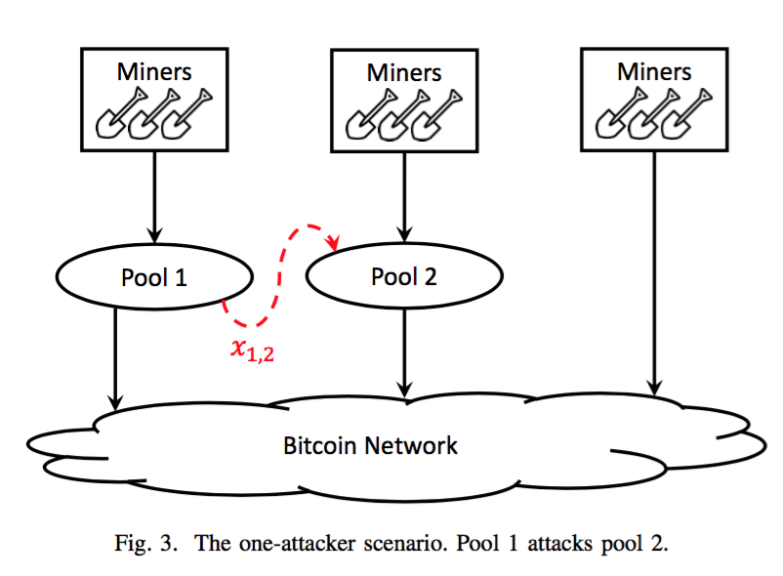
POOL WARS
THE GAME OF LIFE
Attack decisions resemble an iterative game
Two main players: Pool 1 and Pool 2
Each iteration of the game is a case of the Prisoner’s Dilemma
Choose between attacking or not attacking
Notes:
Now lets take our understanding of pool cannibalization and look at this from a game theory perspective.
Read slide
Talk about prisoner’s dilemma and choosing between attacking or not attacking.

Slide 18
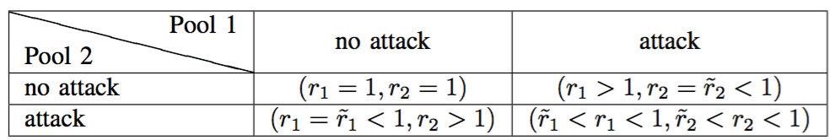
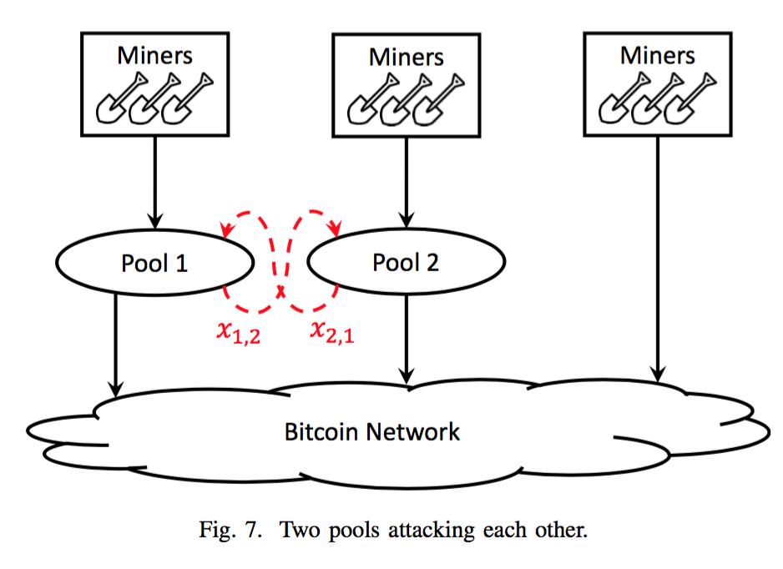
POOL WARS
NASH EQUILIBRIUM
If Pool 1 chooses to attack Pool 2, Pool 1 gains revenue, and Pool 2 loses revenue
Pool 2 can retaliate by attacking Pool 1 and gaining more revenue
Thus, attacking is the dominant strategy in each iteration
Therefore, if both Pool 1 and Pool 2 attack each other, they will be at a Nash Equilibrium
Both will earn less than they would have if neither attacked.
Notes:
From a game theory perspective, you want to maximize your profits, given the probability that other people will attack you and what payouts you get in either case.
Unfortunately, after doing the math, turns out that attacking is the optimal strategy. And this results in nash equillibrium

Slide 19
POOL WARS
TRAGEDY OF THE COMMONS
No-pool-attacks are not a Nash equilibrium
If none of the other pools attack, a pool can increase its revenue by attacking the others
But if the pools agree not to attack, both (or all) benefit in the long run.
However, this is an unstable situation since, on a practical level, you can attack another pool anonymously
If pools can detect attacks, then maybe an optimistic long-term solution is feasible
Nash Equilibrium is a Tragedy of the Commons
Notes:
In an ideal world - could have no pool attack agreement but unstable in long term since this is not practical and you can attack other pools anonymously.
Maybe if pools could detect attacks
Nash equilibrium = Tragedy of the commons
lie in wait attack - mine for pool where you find stuff.

Slide 20
FORKING & DOUBLE SPENDS
Notes:
Talk about how we’re transitioning from ways that miners can cheat vs. how individuals can cheat (through their own publishing of transactions)
First lets define double spending, which is essentially successfully spending the same value more than once.

Slide 21
DOUBLE SPENDING
THE CLASSIC ATTACK
Double Spend: Successfully spending the same value more than once.
In 2099, Gloria wants to buy an iPhone 92XCS from Brian on the black market for 100 BTC but doesn’t want to give up her bitcoins. #HODL
How can Gloria double-spend on Brian?

Slide 22
DOUBLE SPENDING
RACE ATTACK
Suppose Brian simply checks that the transaction he sees is valid and immediately sends Gloria the iPhone. Brian is vulnerable to a Race Attack!
How can we stop this?
Brian
Rest of the network
TX 1
. . .
Gloria → Brian: 100 BTC
iPhone
Included in next block
TX 2
TX 2
Gloria → Gloria: 100 BTC
TX 1
TX 2
Gloria
Other address controlled by Gloria
Notes:
Race condition - other miners could mine on another block
only tells brian about her transaction and tells everyone else that shes sending to self.

Slide 23
DOUBLE SPENDING
CONFIRMATIONS
Confirmations: The number of blocks created on top of the block a txn is in.
Block holding my txn
Most recent block
2 confirmations
1 confirmation
0 confirmations
Notes:
IN order to understand how to defend against this, introduce the concept of confirmations

Slide 24
DOUBLE SPENDING
k CONFIRMATIONS
Clearly not secure if Brian doesn’t wait for any confirmations…
What if Brian waits for k confirmations?
[G → B] transaction needs k confirmations before Brian sends the goods. In order to double spend on Brian, Gloria needs to start a private chain containing her malicious transaction, mine k blocks on top of her block, then broadcast after Brian sends the goods.
Now, Gloria has her money back, even though Brian already sent the goods!
Suppose Brian waits for k = 2 confirmations
Honest Network
k = 2 confs, Brian sends goods
G → B
Gloria broadcasts her chain, which has a higher block height, so the honest network accepts Gloria’s chain over the previous chain.
G → G
Gloria mining blocks, withholding from honest network
Notes:
Go through slides

Slide 25
“CLICKER” QUESTION:
CONFIRMATIONS
How many confirmations should I wait for to be sure my transaction is “valid”?
A) 0
B) 1
C) 2
D) none of these

Slide 26
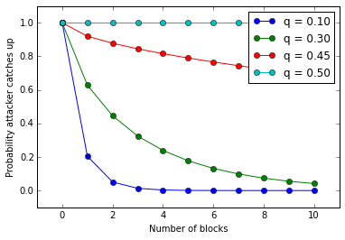
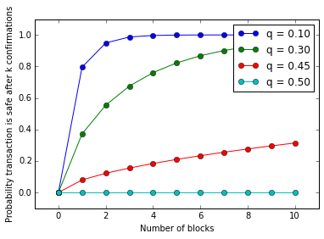
DOUBLE SPENDING
PROBABILITIES
Probabilities of success for the attacker
(Inverse represents bounds of the probability of safety for the vendor given assumptions of the attacker’s hashpower)
Notes:
This slide contains graph of probability that the attacker can catch up and the inverse which is the probability of safety of vendor given assumptions of attackers hashpower. As we can see with lower hashpowers, it is generally safe to say that after 6 confirmations, there is a very low likelihood that the attacker can double spend, however with 50 percent hashpower, we can never confidently sa ythat the vendor is safe.

Slide 27
DOUBLE SPENDING
51% ATTACK
What if Gloria controls more than 50% of the total network hash power?
Whenever Gloria’s chain is behind the honest network’s chain, she will always (in expectation) be able to catch up and out-produce the honest miners.
Therefore, the probability that Gloria can successfully double spend with >50% hash power reaches 100%!
Notes:
Go through slide

Slide 28
DOUBLE SPENDING
INCENTIVES
Why would Gloria not want to double spend?
If the rest of the network detects the double spend, it is assumed that confidence in the cryptocurrency and exchange rate would plummet.
Bribing Miners:
Gloria might not physically control the mining hardware necessary to perform a double spend.
Instead, Gloria can bribe miners or even entire pools to mine on her withheld chain.
What if Gloria is a hostile government / adversarial altcoin / large finance institution with significant capital available?
Gloria can acquire enough mining ASICs or bribe enough miners / pools to achieve >50% effective hash power.
Gloria can perform a so-called “Goldfinger” attack with the objective of destroying the target cryptocurrency, either by destroying confidence in the currency with a double spend or spamming the network with empty blocks. If Gloria isn’t staked in Bitcoin she can short the currency to profit after her attempted double spend.
Ex: Eligius pool kills CoiledCoin altcoin
Notes:
GO through slide

Slide 29
DOUBLE SPENDING
CONFIRMATIONS
If I’m buying a coffee with bitcoin, should I have to wait 6 confirmations
(approx 1 hr) before I can get my coffee? What if I’m buying a house?
Notes:
Now let’s ask ourselves this question.
Point = tradeoff between time efficiency and security, and gauge based on the issue’s importance.

Slide 30
CENSORSHIP
Notes:
In earlier lectures we learnt about blockchain networks being censorship resistant, lets get into some of the math behind it.
Talk about how the premise is now is that Gloria has 51% hashpower, what kind of things can she do other than double spend?

Slide 31


BLACKLISTING
FREEZE PEACH IS DEAD
Say Gloria is a government or has control over a government that has jurisdiction over mining pools. (The Glorian nation)
In addition, Gloria’s mining pools have over 51% of the network’s hash power.
Objective: Censor the Bitcoin addresses owned by certain people, say Brian, and prevent them from spending any of their Bitcoin
Normal block
Block containing transactions from Brian
Normal block
Block mined by Gloria
Notes:
Pose question here - talk about what it means to blacklist

Slide 32
BLACKLISTING
NAIVE CENSORSHIP STRATEGY
First strategy:
Gloria tells her mining pools not to include Brian’s transactions (blacklisting)
Does this strategy actually work?
Notes:
Read

Slide 33
BLACKLISTING
NAIVE CENSORSHIP STRATEGY
First strategy:
Gloria tells her mining pools not to include Brian’s transactions (blacklisting)
Doesn't work unless you are 100% of the network
Other miners will eventually include Brian’s transactions in a block
Can only cause delays and inconveniences
Notes:
Talk about getting lucky, it is kind of censorship in that brian has to wait longer for confirmations and is less incentivized to use his funds for more things

Slide 34

BLACKLISTING
PUNITIVE FORKING
Second strategy:
Remember you are Gloria: you have >51% of the network hash rate
Mandate that Glorian pools will refuse to work on a chain containing transactions spending from Brian’s address
Announce this to the world
Does this strategy actually work?
Notes:
Read through, ask whether this strategy works based on the theory.

Slide 35
BLACKLISTING
PUNITIVE FORKING
Second strategy:
Remember you are Gloria: you have >51% of the network hashrate
Mandate that Glorian pools will refuse to work on a chain containing transactions spending from Brian’s address
Announce this to the world

Slide 36
BLACKLISTING
PUNITIVE FORKING
If miners include a transaction from Brian in a block, Gloria will fork and create a longer proof-of-work chain
Block containing Brian’s transaction now invalidated, can never be published

Slide 37
BLACKLISTING
PUNITIVE FORKING
Non-Glorian miners eventually stop trying to include Brian’s transactions when mining blocks, since they know that their block will be invalidated by Glorian miners when they do
We have now shown how a 51% majority can prevent anyone from accessing their funds. This is called punitive forking.

Slide 38
BLACKLISTING
FEATHER FORKING
Punitive forking doesn't work unless Gloria has >51% of hashpower. Is there another way? Yes! Called Feather Forking
New strategy: Gloria announces that she will attempt to fork if she sees a block from Brian, but she will give up after a while
As opposed to attempting to fork forever; doesn't work without >51%
Ex. Give up after block with Brian’s tx contains k confirmations

Slide 39
￼
BLACKLISTING
FEATHER FORKING
Let q equal the proportion of mining power Gloria have, 0 < q < 1
Let k = 1: Gloria will give up after 1 confirmation (one additional block)
Chance of successfully orphaning (invalidating) the Brian block = q²
If q = .2, then q² = 4% chance of orphaning block. Not very good

Slide 40
￼
￼
￼
￼
BLACKLISTING
￼
FEATHER FORKING
But other miners are now aware that their block has a q² chance of being orphaned. They must now decide whether they should include Brian's tx in their block

Slide 41
BLACKLISTING
EV(include) = (1 - q²) * (BlockReward + Brian's tx fee)
EV(don't include) = BlockReward
Therefore, unless Brian pays q² * BlockReward in fees for his transaction, other miners will mine on the malicious chain
4% * $168,981.25 = 0. 24 BTC = Brian must pay ~$6800 minimum/transaction (march 2023)
FEATHER FORKING

Slide 42
SELFISH MINING
Notes:
consider how rational and malicious actors will behave to increase the amount of money they will make
if there’s a way to increase their revenue, assume they will do so even if its not completely fair
one example is selfish mining

Slide 43
SELFISH MINING
BLOCK WITHHOLDING
You are a miner; suppose you have just found a block.
Instead of announcing block to the network and receiving reward, keep it secret
Try to find two blocks in a row before the network finds the next one
This is called selfish mining or block-withholding
Block n
Block not found yet
Secret block n+1
Note: "block-withholding" is also sometimes used in the context of mining pools - submitting shares but withholding valid blocks
Notes:
suppose you are a miner who has just found a block
you want to give yourself an advantage, so instead of publishing block to network and receiving reward, keep it secret
since you haven’t announced the block, you are effectively the only person working on most recent block (100% hash power on your chain)
no one else can even attempt to solve the hash puzzle
called
Talk about block withholding, - Why? Feather attack? Or just having a one up on other people. You’re gambling that you can find the next block, and having the advantage basically gives you the chance to try to double your reward.

Slide 44
SELFISH MINING
BLOCK WITHHOLDING
If you succeed in finding a second block, you have fooled the network
Network still believes it is mining on the most extended proof of work chain
You continue to mine on your chain
Block n
Block not found yet
Secret block n+1
Notes:
if you find a second block before the network finds the next one, you suddenly have the longest chain
you’ve guaranteed yourself at least two block rewards; if you stay ahead of honest network
network believes it is mining on longest chain
The moment the network is about to catch up to you, you just publish the hidden chain, invalidating honest chain
Since honest nodes will always choose the longest chain
Denies the honest network any chance to do meaningful work
If you succeed> you have fooled the network and you can continue to mine on your chain cause you can broadcast at anytime and win

Slide 45
SELFISH MINING
BLOCK WITHHOLDING
If the network finds a block, you broadcast your two secret blocks and make the network block invalid
While network was working on the invalid block, you got a bunch of time to mine by yourself... for free!
Free time mining on network => higher effective proportion of hashrate => higher expected profits!
New block
Broad cast
Broad cast
AUTHOR: MAX FANG
Notes:
-since you had no competition, you had a higher proportion of the hashrate, leading to higher return
-assumption is that you can find two blocks before the network finds the next block, otherwise your work goes to waste
Once the network almost “catches up” on their chain i.e. mine the chain they thought was longest to within 1 block of your secret chain’s height, you can publish your secret, longer chain which the network will then immediately accept (because it’s longer than the honest chain. Through this, a malicious miner gains free time to mine out of competition with other miners.
While others thought they were mining on the longest chain, you actually had the longest chain.
→ Higher effective proportion of hashrate! → better profits
This case assumes the miner is able to mine a second block more quickly than the network can find a first

Slide 46
SELFISH MINING
BLOCK WITHHOLDING
But what if the network found their new block before you could find a second one? Race to propagate!
If on average you manage to tell 50% of the network about your block first:
Malicious strategy is more profitable if you have >25% mining power
If you have >33% mining power, you can lose the race every time and malicious strategy is still more profitable!
(actual math omitted due to complexity)
New block
Broad cast
Notes:
-becomes race to propagate the new block
-
Risk vs. reward depends on q = % of hashpower, at some point the expected value of withholding will be greater than e.v. Of publishing immediately

Slide 47
DEFENSE DISCUSSION
Notes:
as malicious attackers are trying to attack or subvert the network, honest individuals are incentivized to prevent such behavior
we’ll now take a look at some defenses we have to counter selfish mining

Slide 48
PROBLEM STATEMENT
USE SIGNATURES DUMMY
How do we prevent selfish mining?
Hint: Use signatures

Slide 49
BLOCK VALIDATION
Proposed by Schultz (2015), Solat and Potop-Butucaru (2016)
Accompany solved blocks with signatures on dummy blocks
Proves that the block is witnessed by the network
Proves that a competing block is absent before miners are able to work on it
DUMMY BLOCK SIGNATURES
Broad cast
Sign1
Sign2
Sign3
Sign1
Sign3
Sign7
Sign6
Sign4
Sign2
Broad cast
Secret block
Notes:
In addition to regular blocks, create dummy blocks with signatures
For any given block, easy to verify how many users have seen/signed off on the block
Blocks selfishly mined would only be seen by them, not sufficient signatures
invalidates work they try to do on top of the block they find
Now can anyone think about some potential problems that might exist with this?

Slide 50
PROBLEM STATEMENT
THE PROBLEM WITH DUMMY BLOCKS
Doesn’t provide a mechanism to evaluate whether the number of proofs is adequate
Does not discuss how to prevent Sybil attacks on signatures
Selfish miner generates many signatures on the dummy block
This defense requires fundamental changes to the block validity rules
Broad cast
Sign1
Sign2
Sign3
Sign1
Sign3
Sign7
Sign6
Sign4
Sign2
Broad cast
Secret block
FakeSign5
FakeSign9
FakeSign8
Notes:
No real way of determining how many signatures is enough to show block is valid
What order of magnitude is the threshold number of signatures and would it have to change?
Vulnerable to sybil attacks, they can generate signatures, easy to generate new identities in bitcoin
hard fork, generally undesirable

Slide 51
PROBLEM STATEMENT
How do we prevent selfish mining?
Hint: Use block rewards
Notes:
-next slide, competing blocks receive no reward

Slide 52
FORK-PUNISHMENT
FORK-PUNISHMENT RULE
Proposed by Lear Bahack (2013)
Competing blocks receive no block reward
The first miner who incorporates proof of the block fork in the blockchain gets half of the forfeited rewards
No Block reward
Broad cast
Proof
of
fork
+½ Block reward
Broad cast
Secret block
No Block reward
Notes:
Punishes anyone who forks blockchain
Any competing blocks receive no reward
First miner who proves there was a fork and includes it in the next block gets their block reward and half of forfeited rewards
Disincentivizes malicious users from forking blockchain by working on own secret chain
Incentivizes honest miners to report forks they see
[explain diagram] Since same block height, they are competing blocks
Honest miners run into forks all the time, which is why we don’t want to indiscriminately punish forks by reducing mining reward

Slide 53
FORK-PUNISHMENT
FORK-PUNISHMENT RULE
This defense requires fundamental changes to the reward distribution rules
Requires a hard fork to implement
We have a hard enough time fixing transaction malleability
Can we do better?
Drawbacks
Honest miners suffer collateral damage of this defense
And lead to more attacks...
No Block reward
Broad cast
Proof
of
fork
+½ Block reward
Broad cast
No Block reward
Notes:
Punishes all competing blocks; honest miners suffer collateral damage, leads to other attacks
can we do better?
think about the environment our problem is posed in
To answer whether we can do better, we need to think more about the existing conditions our problem is posed in. Let’s talk about network dominance.

Slide 54
THE BITCOIN NETWORK
A CLOSER LOOK
What do we mean by p2p?
Gossip protocol (flooding)
8 outbound connections, 117 inbound (pseudorandom) connections
Need to understand how information propagates
Topology
Network latency
Rustie
Gloria
Derrick
Nick
Nadir
Notes:
Asynchronous
Peer to peer, no central entity
Gossip protocol (send to neighbors, they tell their neighbors)
Join by recursive procedure, hardcoded into bitcoin core software is a list of seed peers you connect to initially (ask these nodes for their neighbors, pick some, ask them, repeat until random set of neighbors)
max 125 connections
Topology is how it'd look if you graphed it out
network latency, how long it takes info to travel from one end to another end (important because block propagation defines our version of truth)
Some nodes are more influential than others and this is difficult to distinguish since nodes coudl be dummy nodes or pseudonymous and one attacker could have multiple nodes
Earlier we talked about how even with decreasing amounts of computational power it is still profitable for people to selfish mine, lets see how this plays into that

Slide 55
THE BITCOIN NETWORK
AN UNEVEN TOPOLOGY
Some nodes are more influential than others
Uneven distribution of hash power
Hard to distinguish network topology
Miner
Rustie
Gloria
Miner
Derrick
Miner
Nick
Miner
Nadir
Notes:
Want it to be fairly uniform, have same weight (mining power), have random connections,
but some nodes have more mining power
for example, if Derrick has high hash rate, might be running mining farm or pool,
(END) Hard to distinguish network topology; miners don’t need to be connected to network at all (could be secret subgraph) (END)
say derrick has an amazingly high hash rate…could be that he’s running a mining pool or farm. can’t really tell, esp since farms/pools sometimes want to remain secret so ppl dont attack them. (conspiracy: pools disguise their power...50%??)
All his pool or farm miners connect directly to him. arguably more influential than other nodes in the network.
Contrast this with if someone’s just an spv node hanging out in the network, or a solo miner for fun.

Slide 56
THE BITCOIN NETWORK
AN UNEVEN TOPOLOGY
Bitcoin safe as long as >50% network is honest?
Incentive alignment
See selfish mining
33%, 25%, 23.2%, 32%, ...
Miner
Rustie
Gloria
Miner
Derrick
Miner
Nick
Miner
Nadir
Notes:
Derrick could hide that he has more than 50% of hash power by multiple identities (which he doesn't even need)
say derrick has an amazingly high hash rate…could be that he’s running a mining pool or farm. can’t really tell, esp since farms/pools sometimes want to remain secret so ppl dont attack them. (conspiracy: pools disguise their power...50%??)
All his pool or farm miners connect directly to him. arguably more influential than other nodes in the network.
Contrast this with if someone’s just an spv node hanging out in the network, or a solo miner for fun.

Slide 57
THE BITCOIN NETWORK
NETWORK LATENCY
Different propagation times
Getting data items out to the network quickly
Block propagation races
Leads to disproportionate profits
Rustie
Gloria
Derrick
Nick
Nadir
Notes:
also consider network latency
a selfish Miner could publish secret blocks right before considered late, some nodes will see it
Two miners found blocks at same time, the better connected would win, disproportionate profits in miners, miners better connected are able to see blocks and send out blocks faster
two miners find block at the same time, race to propagate like before,
connection to nodes
network latency
connection to fast nodes

Slide 58
THE BITCOIN NETWORK
SYBIL ATTACK REVISITED
Derrick
Derrick
Derrick
Flood the network with 0-power nodes
Sybil attack on honest miners
0-power nodes as sensors
Publish secret block P when hear of competing block X
Ignore X, replay P
If P reaches miner before X, then mine on P
P
Derrick
P
P
Derrick
Rustie
P
Gloria
P
P
P
P
Derrick
Derrick
P
P
Nick
P
P
Nadir
Derrick
P
Derrick
Derrick
P
P
Derrick
Derrick
X
Notes:
think back to sybil attacks in past lectures, not beneficial to have more identities, where we make computational power the limiting factor
if we are clever enough, we can launch a sybil attack in a different way.
just listening nodes, acting like sensors
outpace the honest block
Sensor nodes notify the person doing selfish mining when they should start propagating their withheld block (and choose purposefully not to propagate the block that they sense)

Slide 59
PROBLEM STATEMENT
How do we prevent selfish mining?
Claim: The problem is that we reward the longest chain.

Slide 60
TIE-BREAKING
UNFORGEABLE TIMESTAMPS
Proposed by Eyal and Sirer (2014)
In the case of a tie, a miner randomly chooses which chain to mine on
Prevents an attacker from benefiting from network-level dominance
Raises the profit threshold from 0% to 25% under their strategy
Sapirshtein (2015) proposes a more optimal selfish mining strategy
Reduces Eyal and Sirer profit threshold to 23.2%
0.5
Broad cast
Wait to hear about all competing blocks
0.5
Broad cast
Secret block
Notes:
Instead of punishing everyone, another way Prevent block propagation race
Consider each submitted block at each block height
Uniform Tie-Breaking
When there is a race to propagate, miner who has network advantage is most likely to get their block accepted (Better connected to network, can get it to more people)
After each block is published, instead of taking first seen block as valid, each miner first waits to hear about all competing blocks.
In case of tie, miner randomly chooses which chain to mine on -- miners mitigate an attackers network level dominance
Found default bitcoin protocol has a profit threshold of 0% if there exists selfish miners that are really well connected in network, and can influence how data flows
With uniform tie-breaking, profit threshold is 25%, but separate paper proposed more optimal strategy that reduced it to 23.2%
25% still low, considering selfish mining always profitable when u have 33% of mining power
Mailbox analogy, have a window of time, randomly choose.
The problem that Sirer & other guy noted was that anyone with network-level dominance will get their blocks to miners more quickly upon completion. This enhances the ability of selfish miners to beat out the competition. By removing the advantage of getting your block first to miners by having miners wait before selecting a block,

Slide 61
TIE-BREAKING
Proposed by Ethan Heilman (2014)
Each miner incorporates the latest unforgettable timestamp issued by a trusted party into the working block
Timestamp is publically accessible and unpredictable
Issued with an interval of 60s
When two competing blocks are received within 120s, a miner prefers the block whose timestamp is "fresher"
Claim: Raises the profit threshold to 32%
UNFORGEABLE TIMESTAMPS
Timestamp
6:00 pm
6:10 pm
6:21 pm
6:32 pm
Broad cast
Broadcast new unforgeable timestamp every 60s
6:30 pm
Broad cast
Notes:
Issued by trusted party, incorporated into every block
Global across entire network, issued regularly, ie. 60s
Publicly accessible but unforgeable (using cryptographic signatures)
Blocks are considered competing
Miners simply pick timestamp which is fresher/more recent
Raises profit threshold to 32%
Another similar solution is to have a centralized entity publish a timestamp

Slide 62
TIE-BREAKING
UNFORGEABLE TIMESTAMPS
Drawbacks
Tie-breaking rules don’t apply when the selfish mining chain is longer than the public chain
Only applies to a block propagation race
If an attacker has a large amount of computational power >40% then these defenses are essentially worthless
Timestamp
6:00 pm
6:10 pm
6:21 pm
6:32 pm
Broad cast
Broadcast new unforgeable timestamp every 60s
6:25 pm
6:31 pm
Broad cast
Secret block
Notes:
Drawbacks
Tie breaking rules apply when there is a block propagation race, not when selfish mining longer chain
If attacker has a large amount of computational power, defenses worthless

Slide 63

TIE-BREAKING
UNFORGEABLE TIMESTAMPS
Drawbacks
Introducing trusted third party contradicts the Bitcoin philosophy
CENTRALIZATION
Notes:
This requires trusted third party, bitcoin aims to be decentralized,

Slide 64
PROBLEM STATEMENT
How do we disincentivize selfish mining even when the selfish miner has a longer chain?

Slide 65
PUBLISH OR PERISH
ZHANG AND PRENEEL, "PUBLISH OR PERISH" (2017)
Ren Zhang and Bart Preneel (Apr 2017) claim the best-yet defence of selfish mining
Backwards compatible: No hard fork
Disincentivizes selfish mining even when the selfish miner has a longer chain
Approach: A novel Fork-Resolving Policy (FRP)
Replace the original Bitcoin FRP (length FRP) with a weighted FRP
Embed in the working block the hashes of all its uncle blocks
Note that selfish mining is premised on the idea of first building a secret block
Idea: Make sure this secret block does not help the selfish miner win the block race

Slide 66
PUBLISH OR PERISH
ZHANG AND PRENEEL, "PUBLISH OR PERISH" (2017)
Definitions
𝜏: An assumed upper bound on the amount of time it takes to propagate blocks across the Bitcoin network
In time. Evaluated from the miner’s local perspective.
Height value is greater than that of the local head OR
Height value is same as that of the local head, but was propagated within 𝜏 time
H
Local
Head
H
H + 1
H
Local
Head
Time in seconds
within
𝜏 sec

Slide 67
PUBLISH OR PERISH
ZHANG AND PRENEEL, "PUBLISH OR PERISH" (2017)
Definitions
Uncle. Different from Ethereum’s definition of an uncle
The uncle of a block B is one less the height of B
The uncle has to be on time with B’s parent
Weight. Since two competing chains always have a shared root, only consider blocks after that
weight = # of in-time blocks + # of uncle hashes embedded in these blocks
Not Uncle
(D)
Root
(R)
Parent
(A)
Child
(B)
Uncle
(C)
Time in seconds
within
𝜏 sec
not within
𝜏 sec

Slide 68
PUBLISH OR PERISH
ZHANG AND PRENEEL, "PUBLISH OR PERISH" (2017)
Zhang and Preneel's Weighted Fork Resolving Policy:
If one chain is longer height-wise than the other(s) by k or greater blocks*
The miner will mine on this chain
Otherwise, the miner will choose the chain with the largest weight
If the largest weight is achieved by multiple chains simultaneously, then the miner chooses one among them randomly
*Aside: k is a "fail-safe parameter" that gauges the allowed amount of network partition. Note that when k = ∞ the first rule never applies.

Slide 69
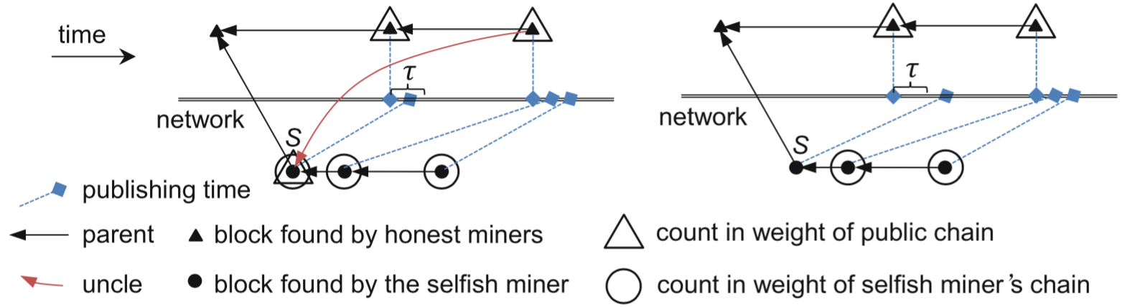
PUBLISH OR PERISH
ZHANG AND PRENEEL, "PUBLISH OR PERISH" (2017)
Miner has one secret block. A competing block is published. Block race! Miner has two options:
Option 1: If the selfish miner publishes their block, the next honest block gains a higher weight by embedding a proof of having seen this block
Option 2: If the selfish miner keeps their block secret, the secret block does not contribute to the weight of its own chain
In both scenarios, the secret block does not help the selfish miner win the block race
Choice 1: Publish
Choice 2: Don't publish

Slide 70
PUBLISH OR PERISH
ZHANG AND PRENEEL, "PUBLISH OR PERISH" (2017)
Same scenario revisited. More rigorously, let 𝑆 be the first selfish block
Option 1: Selfish miner publishes 𝑆
𝑆 will be an uncle of the next honest block
(since it was published in time and its height is one less)
=> 𝑆 counts into the weight of both the honest and the selfish chain
Choice 1: Publish

Slide 71
PUBLISH OR PERISH
ZHANG AND PRENEEL, "PUBLISH OR PERISH" (2017)
Option 2: Selfish miner doesn't publish 𝑆
Selfish miner waits, and publishes it later as a part of the selfish chain
Honest miners do not count 𝑆 into the weight of the selfish chain because 𝑆 is not in time.
It is a late block
𝑆 is not an uncle of the next honest block because the honest miners did not see it
=> 𝑆 contributes to neither the weight of the honest nor the selfish chain
Choice 2: Don't publish

Slide 72
PUBLISH OR PERISH
ZHANG AND PRENEEL, "PUBLISH OR PERISH" (2017)
Result: Regardless of which option is chosen...
𝑆 will not contribute to only the weight of the selfish chain.
Will only contribute to both or neither
Completely nullifies the advantage of the secret block 𝑆 !
Choice 1: Publish
Choice 2: Don't publish
AUTHOR: MAX FANG

Slide 73
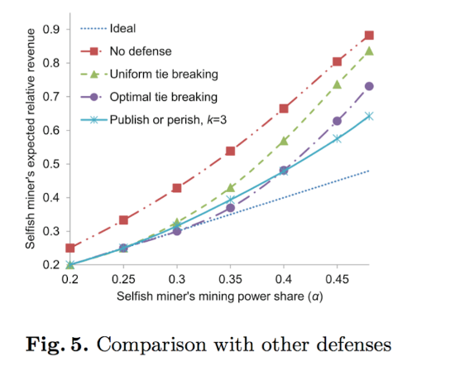
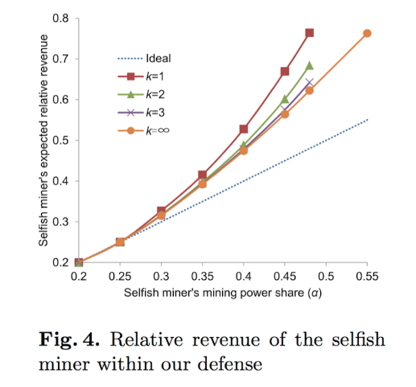
PUBLISH OR PERISH
ZHANG AND PRENEEL, "PUBLISH OR PERISH" (2017)

Slide 74
PUBLISH OR PERISH
ZHANG AND PRENEEL, "PUBLISH OR PERISH" (2017)
Limitations
Bitcoin aims to be asynchronous, Publish and Perish assumes synchronicity
(Because it assumes an upper bound of block propagation time)
Because of this, it's basically useless
When the fail-safe parameter k > 1, an attacker may broadcast blocks right before they are late to cause inconsistent views among the honest miners
Several other selfish mining defenses also require a fixed upper bound on the block propagation time in order to be effective
During the transition period to weighted FRP, an attacker can launch double-spend attacks
Neglects real world factors:
Does not permit the occurrence of natural forks
Does not consider transaction fees on the selfish miner’s strategy
Does not consider how multiple selfish miners could collude and compete with each other
Does not achieve incentive compatibility, but is the closest scheme to date

